Slide 1
Network Emulation and QoE Analysis for H264 Adaptive Streaming
By Hammad Shafiq and Hassan Farooq

Slide 2
Introduction
Environment setup completed.
Puppeteer used for network emulation.
QoE (Quality of Experience) metrics recorded and analyzed.
All results documented with visual evidence.

Slide 3
Requirements
Set up the Environment:
HTTP server for serving videos and manifest file.
Shaka player for adaptive streaming playback.
Integrate Network Emulation
Simulate bandwidth conditions (3G, Slow4G, Fast 4G, Wi-Fi).
Collect Metrics and Analyze QoE
Startup Delay.
Rebuffering Events.
Average Bitrate.
QoE Scores.

Slide 4
What is Puppeteer?
Puppeteer is a Node.js library that provides a high-level API to control Chrome or Chromium browsers. It enables automation of browser tasks, such as:
Network emulation.
Headless browsing.
Web scraping and testing.
Features:
Precise control over network and performance conditions.
Easy-to-use API for automating web interactions.
Ideal for testing adaptive streaming systems.

Slide 5
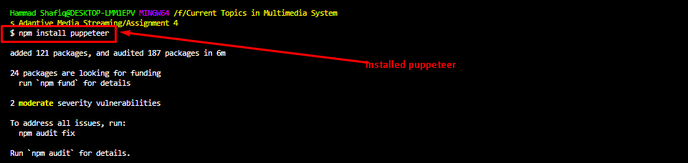
What is Installation

Slide 6
Environment Setup
HTTP Server:
Server.js : Serves video files and the manifest file.
Shaka Player:
Index.html : Renders the video player and initializes playback.
Dependencies Installed:
Node.js and required modules.
Puppeteer for bandwidth throttling.

Slide 7
Network Emulation Setup Approach
Puppeteer Installed:
Automated Chrome browser control.
Enabled network emulation.
Network Conditions Simulated:
3G: Low bandwidth with high latency.
Slow 4G: Moderate bandwidth and latency.
Fast 4G: High bandwidth and low latency.
Wi-Fi: Very high bandwidth with minimal latency.

Slide 8
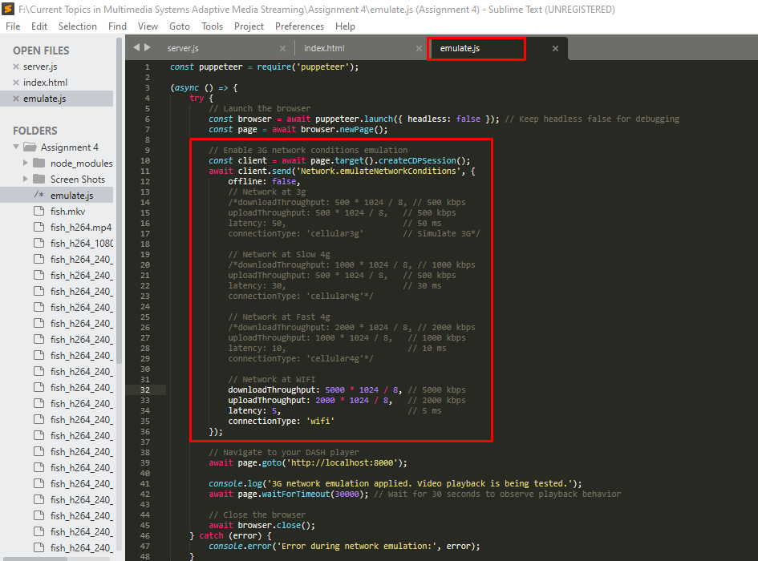
Emulate.js File

Slide 9
Shaka Player Configuration
Manifest File:
Lists available representations (240p, 360p, 720p, 1080p).
Adaptation Logic:
Selects appropriate quality based on available bandwidth.
Video Segment Fetching:
Ensures seamless playback by fetching segments adaptively.

Slide 10
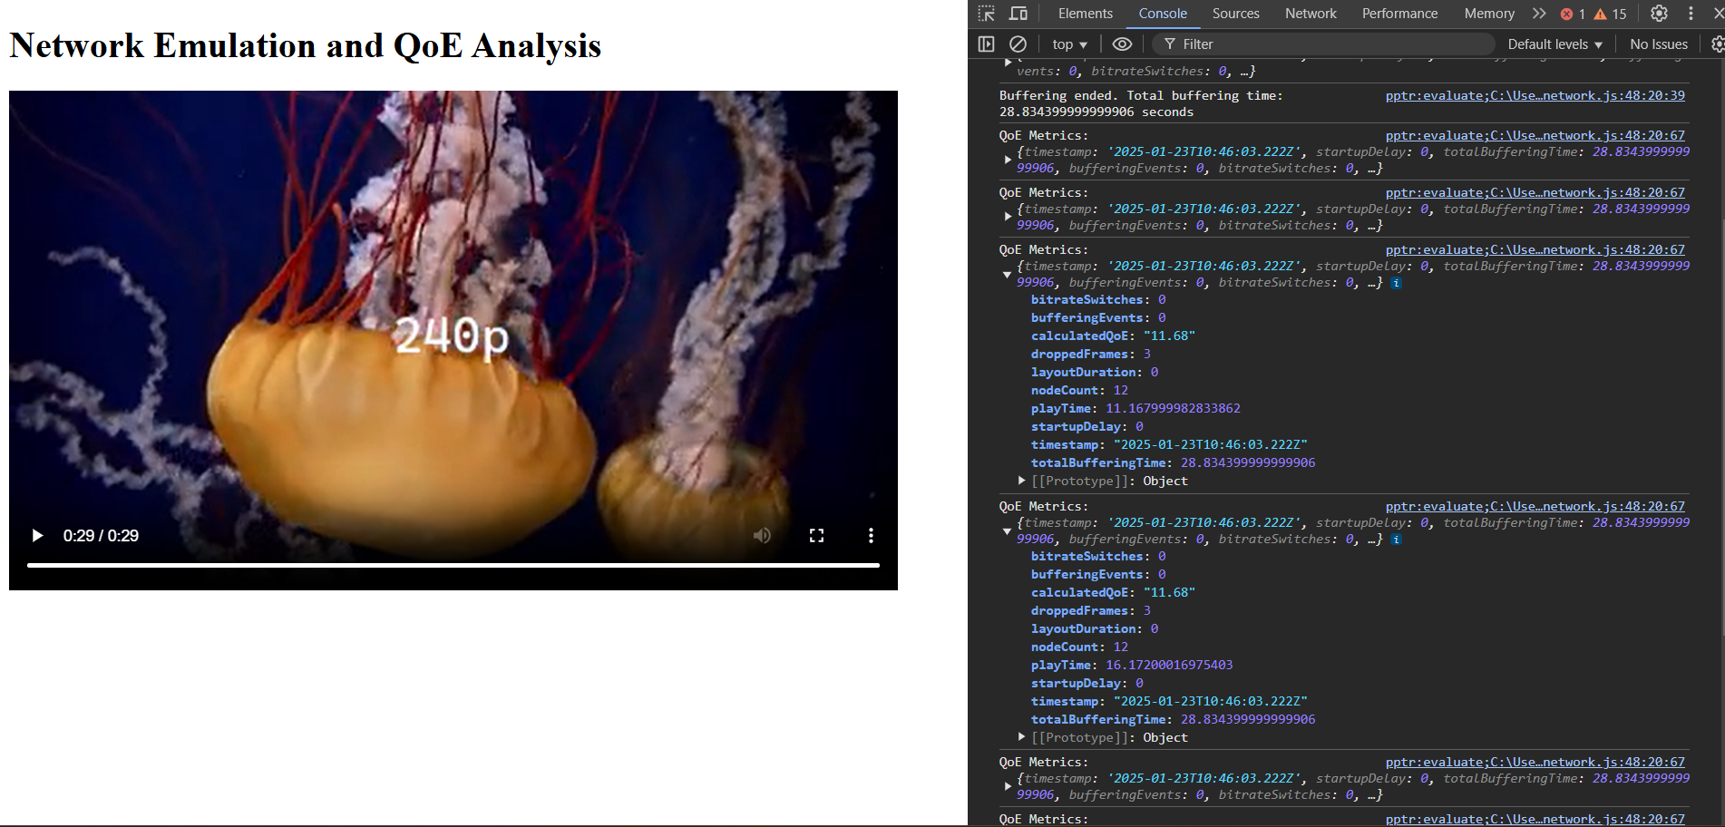
Throttling At 3G

Slide 11
Throttling At 3G
bitrateSwitches: 0
bufferingEvents: 0
calculatedQoE: "11.68"
droppedFrames: 3
layoutDuration: 0
nodeCount: 12
playTime: 11.167999982833862
startupDelay: 0
timestamp: "2025-01-23T10:46:03.222Z"
totalBufferingTime: 28.834399999999906

Slide 12
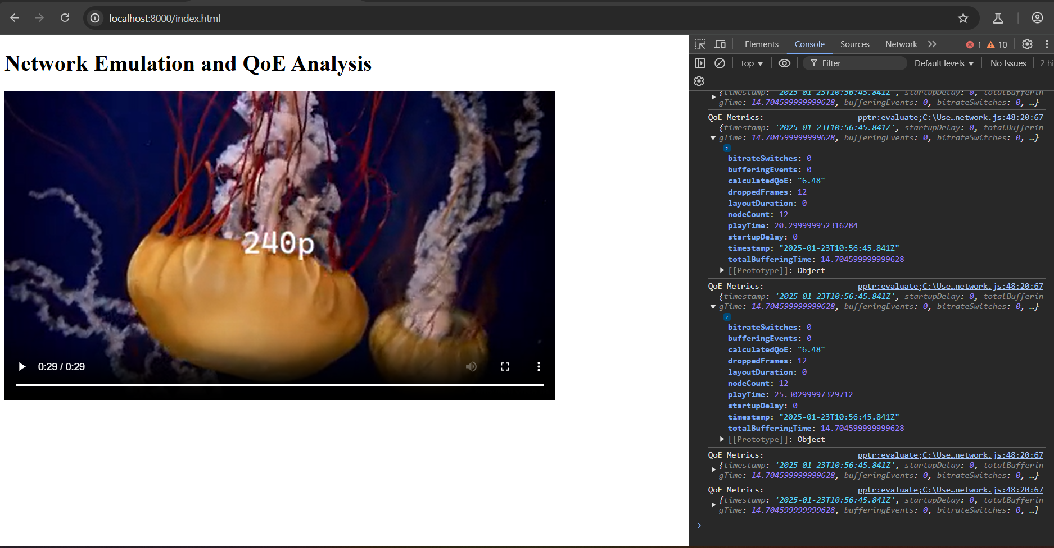
Throttling At Slow 4G

Slide 13
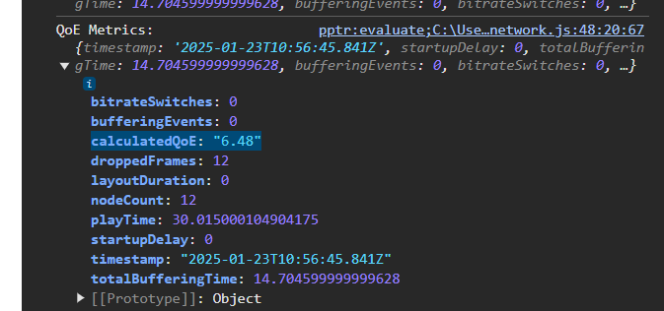
Throttling At Slow 4G

Slide 14
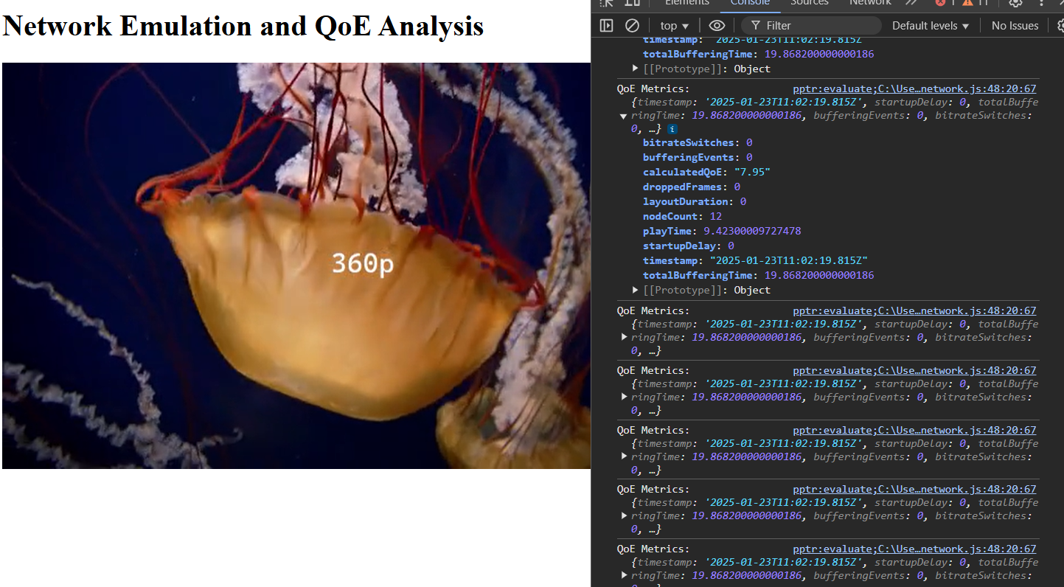
Throttling At Fast 4G

Slide 15
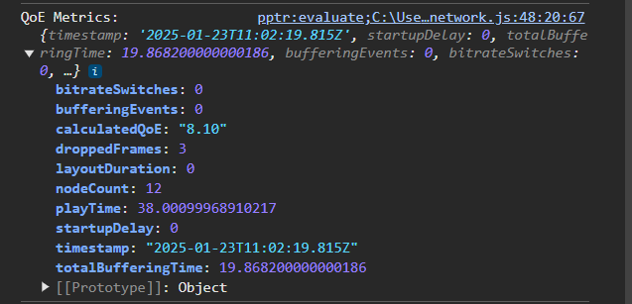
Throttling At Fast 4G
Observations:
Smooth playback but no switch to higher quality.

Slide 16
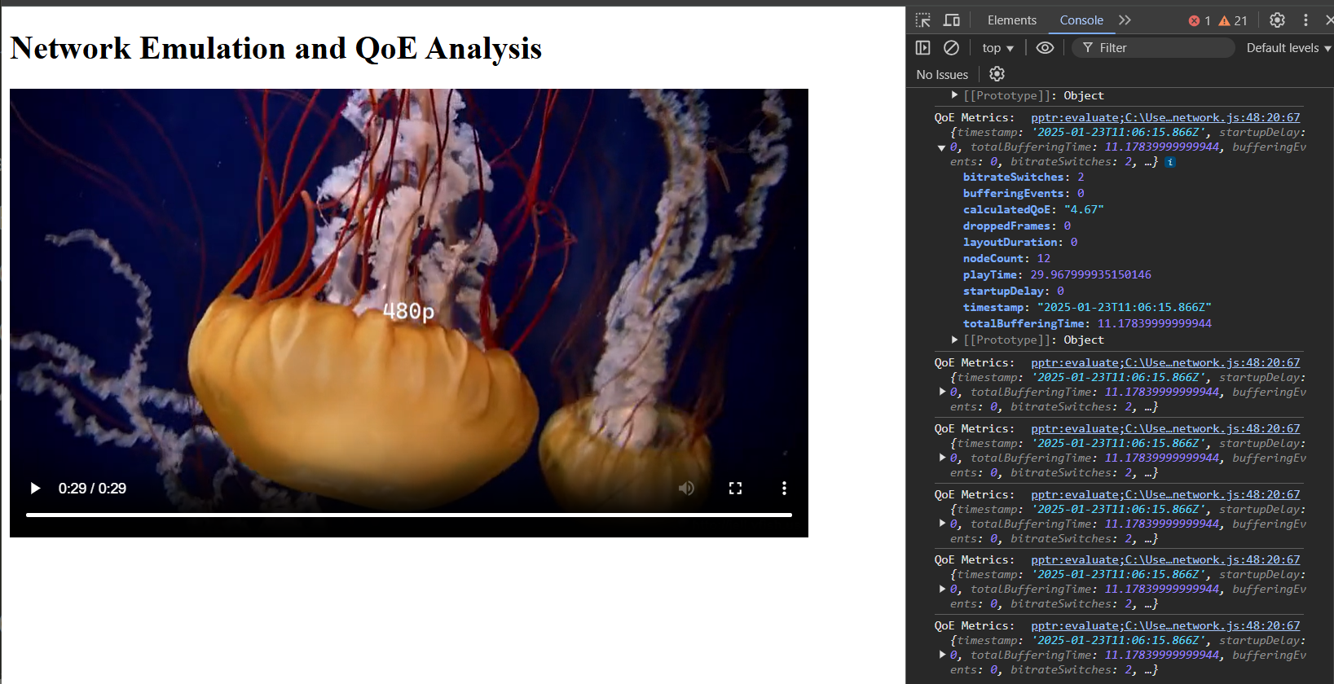
Throttling At WIFI

Slide 17
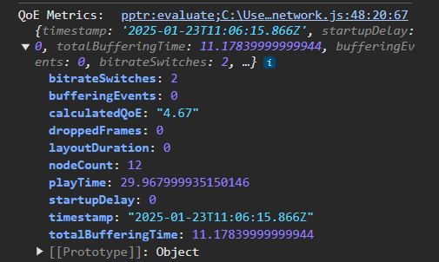
Throttling At WIFI
Observations:
Minimal startup delay.
Excellent playback smoothness but sticking to 480p.

Slide 18
THANK YOU!

